Slide 1
Which option is better? Analysis on On-Campus Housing Vs Off-Campus Housing
Team MEMBERS: -
Jeet KETAN Thaker
Project guide: -
Prof. Jeibo Luo

Slide 2
motivation
A student when enrolled in an undergrad or grad programs gives 4 or more years of his/her life dedicated to studying.
Considering such a huge amount of time its natural that where the person will live will be a huge factor in the students development. Both academically and non academically.
Students face a lot of academic pressure and it is in their best interest to find the happiest place that they can live in.
Therefore we do a sentiment analysis to measure sentiment levels across different places , using wisdom of the crowds to find the best place possible.

Slide 3
Objective of the project
To determine if there is a difference in sentiment levels of students who live on-campus and students who live off campus.
To answer the question , “Which is better , on campus or off campus housing?”

Slide 4
Methodology
Scrape data off reddit taking into account the most popular university subreddits using queries like “on campus”, “off campus”, “housing”, “dorm”.
Clean the data up (lower case , remove punctuations , remove stop words , lemmatize) and perform frequent itemset mining using FP-Growth algorithm.
Using the data got from reddit and using VADER do a sentiment analysis over the data set to gauge sentiment levels under variety of parameters (By region , By university , Across Regions etc)

Slide 5
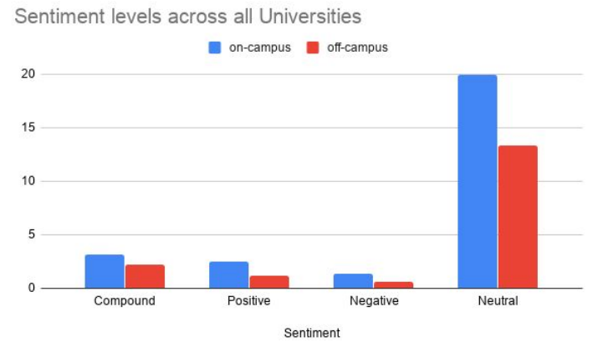
Results
Notes:
Overall off campus housing is preferred over on campus housing. Even though negative sentiments are higher for on campus housing , the positive sentiments cover for it

Slide 6
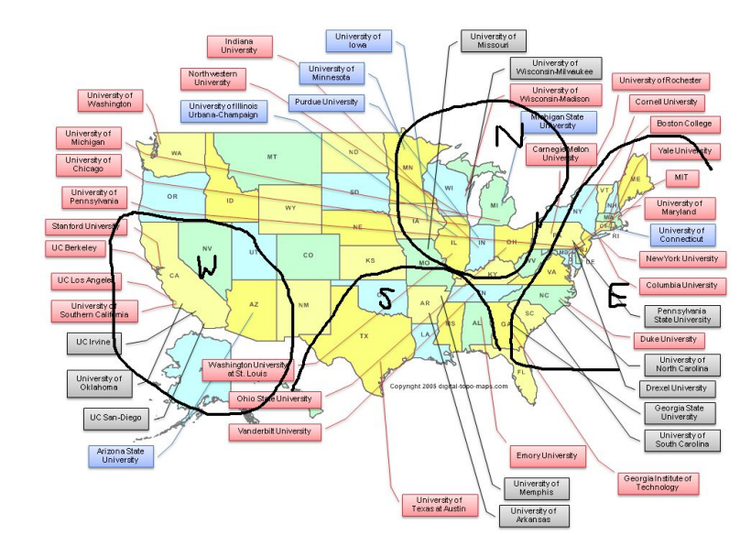
Separate universities by region
Notes:
The map with manually drawn regions under which universities fall
(Source : ​https://aacademy.files.wordpress.com/2009/09/university_map.png​)

Slide 7
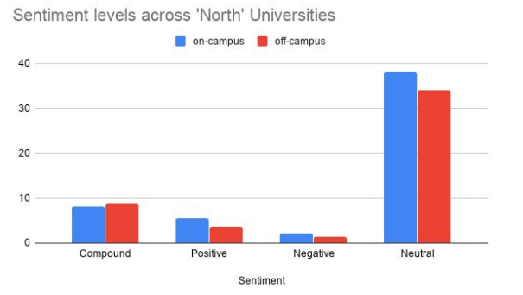
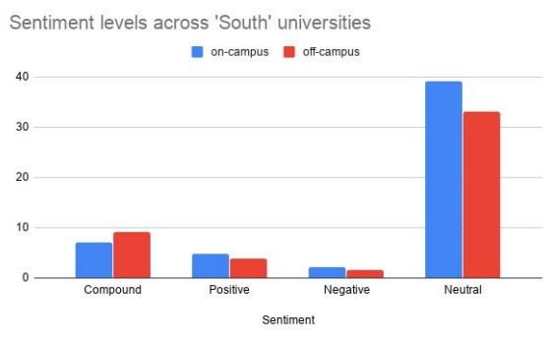
Results across different regions
Notes:
North and South regions , off campus housing is better over on campus housing

Slide 8
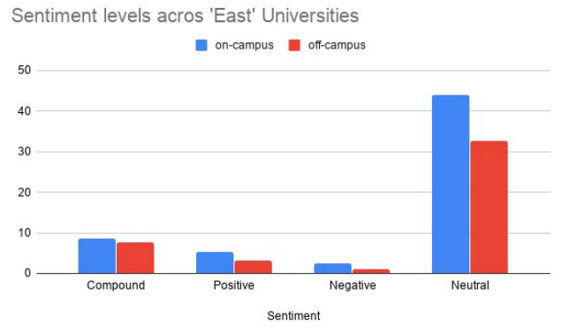
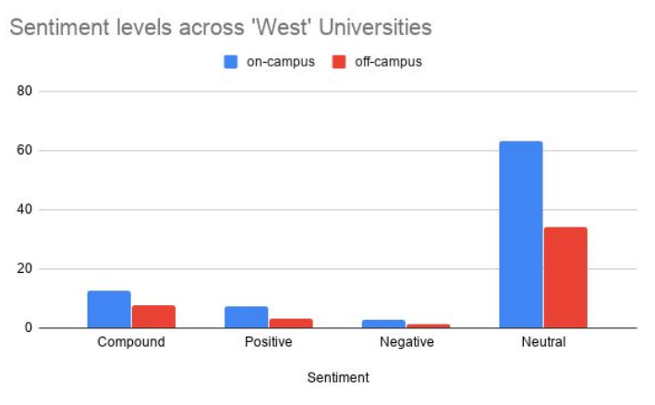
Results across different regions
Notes:
East and West regions , on campus housing is better over off campus housing

Slide 9
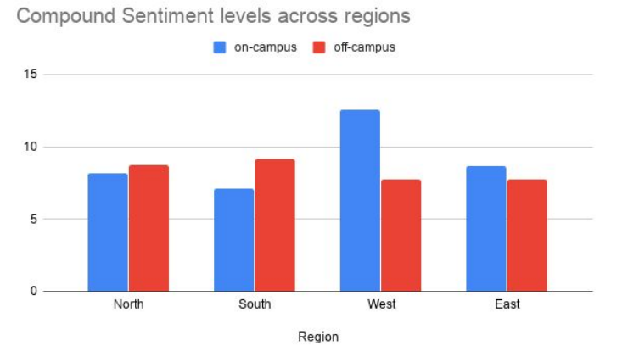
Results Among different regions
Notes:
On campus house rankings :- West > North > East > South
Off campus house rankings :- South > North > East > West

Slide 10
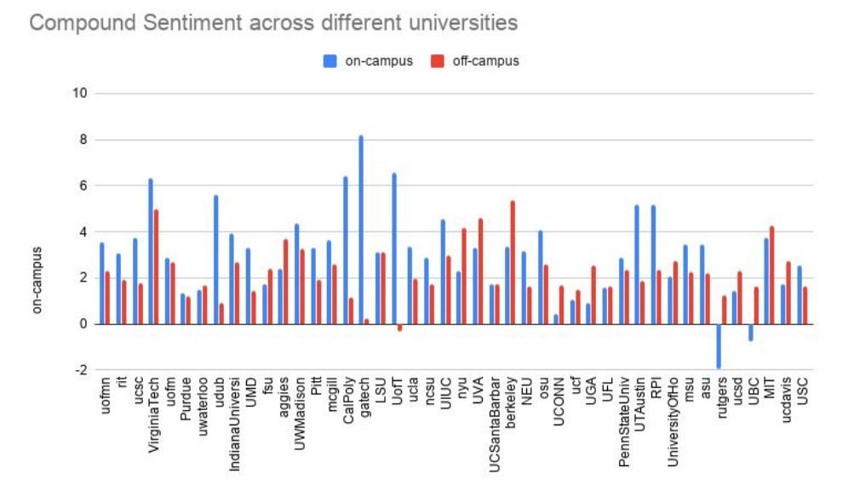
Results Among different universities
Notes:
Best on campus housing – Gatech
Best off campus housing – berkely , NYU

Slide 11

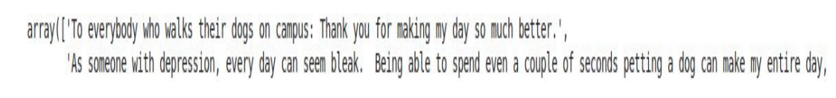
Posts that had some of the highest positive sentiment

Slide 12
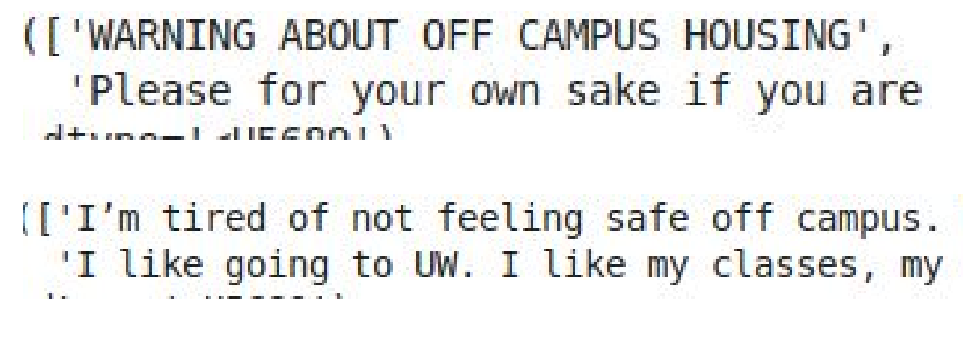
Posts that had some of the highest negative sentiment

Slide 13
Conclusion
Overall on campus housing is happier than off campus housing.
If we look according to regions the west region is happiest for on-campus housing.
If a student wants to go for off-campus housing then the south region is the happiest.
There are some universities which have higher levels of happiness off campus than on campus. (eg. NYU)
There are not many happy/sad events occurring in day to day life , the happiest event occur off campus but very sparsely , on campus events which are happy in nature occur often but the value of the sentiment is not as high as the happiest of the off campus events.
From the graph showing comparisons between universities one can draw other variety of conclusions by comparing and contrasting.
Parking is important to students in terms of housing.
If decided on a dorm then the most important thing is the Wifi and the Ethernet services there.

Slide 14
Future work
The frequent set item mining was done using only the titles of the posts as performing it on the body of the post was time intensive. It would give us better results if we perform it on the body as well.
Posts with a question type nature can be isolated, of the type , “Which is better , off campus or on campus?” and the top comment on the post can be analysed to know about which is better and why exactly.
This time I performed clustering manually, but we can run sentiment analysis over posts from different universities and then use clustering over the result to find clusters which naturally arise due to sentiment values and not only by geographic location

